Slide 1
DATA ANALYSIS
British Airways Customer Reviews

Slide 2
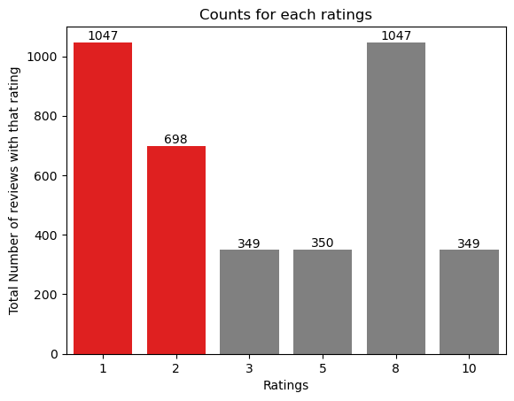
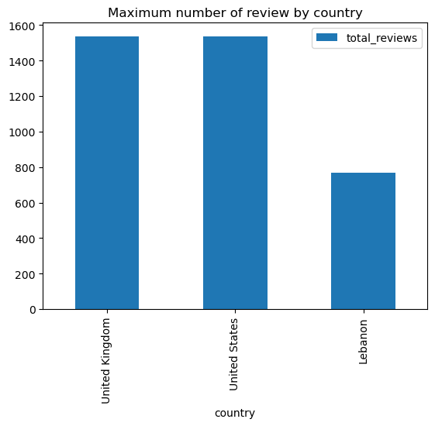
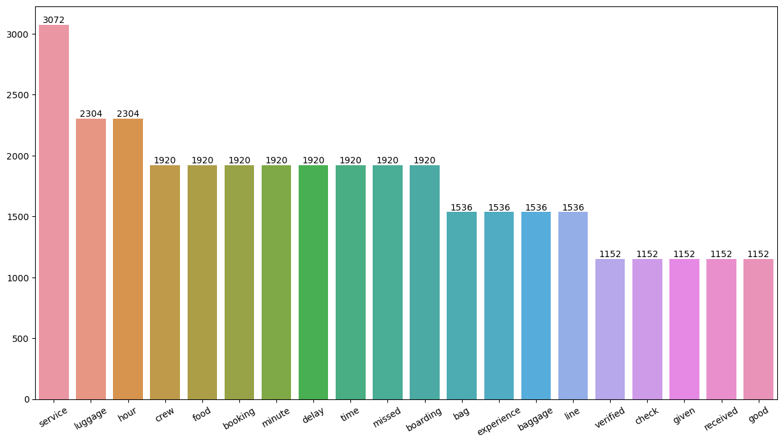

Key Metrics
Overall Rating
4.45 /10
Total Reviews
3840
Countries
3
Classification By rating :
7-10: Good Food, Comfortable seats, Friendly Crew 4-6: Long lines, bad business class experience
1-3: Delay flights, more connecting flights, seat problems

